Slide 1
Developing a Student Mindset for Successful Learning
Stephen L. Chew, PhD
Department of Psychology
Samford University
slchew@samford.edu Twitter: @SChewPsych
Tennessee Association for Student Success and Retention (TASSR)
October 3, 2019

Slide 2
Goals of this Presentation
To review the scope of the challenge of getting students to learn
To discuss ways to help students develop good study and learning habits based on cognitive principles

Slide 3
The Cognitive Challenges to Teaching (that we know about thus far)
Student Mental Mindset
Metacognition and Self-regulation
Student Fear and Mistrust
Prior knowledge
Misconceptions
Ineffective Learning Strategies
Transfer of Learning
Constraints of Selective Attention
Constraints of Mental Effort and Working Memory

Slide 4
Student Mental Mindset
Student mental mindset is his or her attitudes, beliefs, and expectations about learning and the whole academic context
The teacher, course, topic, pedagogy, assessment, curriculum, major, and school
Mental mindset affects more than self-assessment; it affects all of their study behavior

Slide 5
Messages from Struggling Students Reflecting Mindset
“I read through my notes and I skimmed the chapters.”
“I’m going to have to read more of the book for the next exam.”
I knew I wasn’t going to do well because I forgot about the exam until the morning we were going to take it.
“I just didn’t want to study the brain because it wasn’t interesting to me”

Slide 6
Improving Academic Mindset
Fixed vs. Growth Beliefs in Intelligence
Productive Persistence
Wise Feedback
Self-Transcendent Purpose

Slide 7
Responses to Many Situations are Based on Mindset
 | Fixed Mindset Response | Growth Mindset Response
Challenges | Avoid | Embrace
Obstacles | Give up easily | Persist
Tasks requiring effort | Fruitless to Try | Path to mastery
Criticism | Ignore it | Learn from it
Success of Others | Threatening | Inspirational

Slide 8
Fixed Mindset Message
I realize it is the night before our second test. I’m writing now because if I don't than I will somehow convince myself everything is okay and then I won't ask for any help. Statistics is an ocean in which I am drowning. I have tried studying with friends and it has not been any help, first of all they are way ahead of me and when I say I don't understand they don't really get that I truly have no idea what is happening. I would love to stop by your office and ask a question, but I do not know the question to ask. I need help from someone who actually has the time, and energy to help me from the ground up. …Do you know of somehow I can get tutoring…
Notes:
Knew she had a weak math background and high math anxiety
Missed multiple classes
Often texts during class
Has never came to see me
Failed the first exam and still not come to see me despite my message asking her to do so
Has come to the conclusion that she needs a tutor
Assumes can catch up with class even though semester is half over

Slide 9
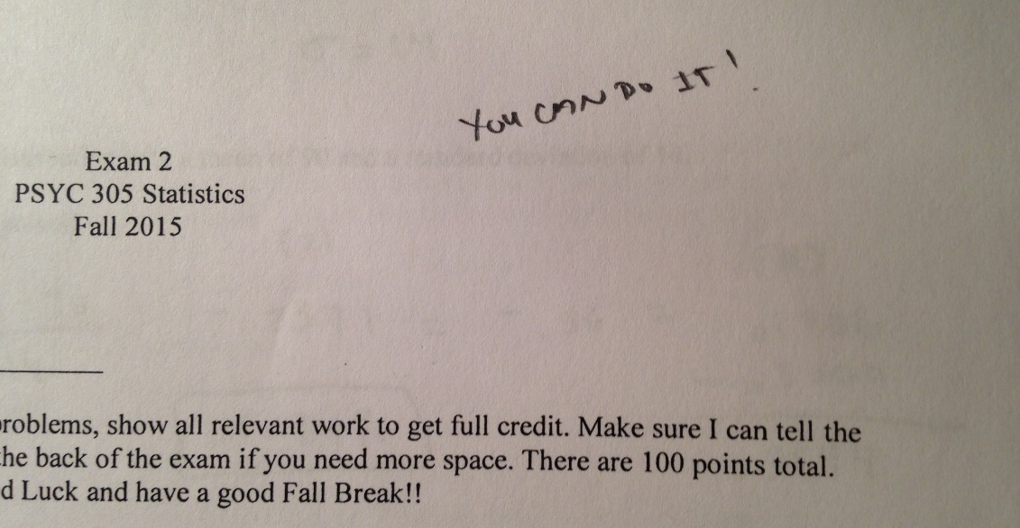
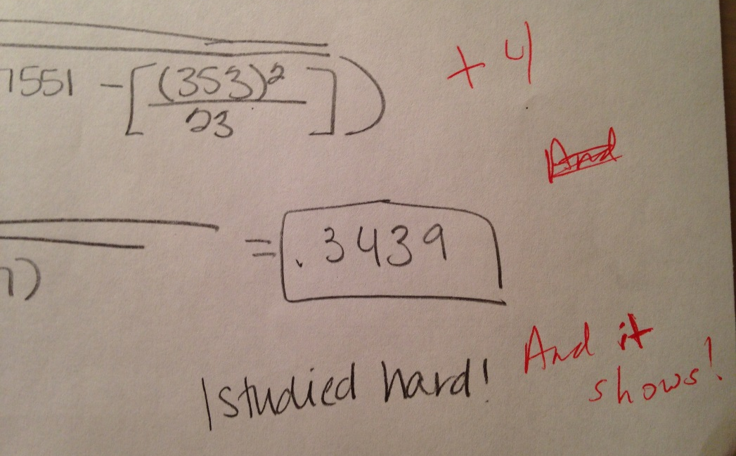
Growth Mindset Messages

Slide 10
Fixed vs. Growth Feedback
Fixed
Growth
“I’m not smart enough to do this.”
“I’m not good at math”
“I’m not a science person“
“This paper shows you are a good writer”
“With the right effort and help, I’m capable of doing this.”
“I have to work extra hard at math”
“I can’t let myself fall behind in science.”
“You put a lot of work into this paper, and it shows.”

Slide 11
Productive Persistence Silva & White (2013)
[P]roductive persistence is the package of skills and tenacity that students need to succeed in an academic setting.
For many struggling students, “Do you think I can do this?” actually means, “Do you think I belong here?”

Slide 12
Productive Persistence Mindset
I belong in this academic community
My ability and competence grow with my effort
I can succeed at this
This work has value for me

Slide 13
Wise Feedback (Yeager, et al., 2013)
Critical feedback must be conveyed as a reflection of the teacher’s high standards and not their bias
Students must be assured that they have the potential to reach these standards
Students must also be provided with the resources and methods to reach the standards

Slide 14
Self-Transcendent Purpose (Yeager, et al., 2014)
Learning to accomplish a self-transcendent goal increases persistence and self-regulation

Slide 15
Other Methods
Exam Wrappers
Cognitive Reappraisal
Intense Study Sessions

Slide 16
Exam Wrappers
An activity carried out after an exam that makes students reflect on their level of preparation, study skills, and metacognitive awareness
Developed at Carnegie Mellon http://www.cmu.edu/teaching/designteach/teach/examwrappers/
Does not focus on content

Slide 17
Previous Exam Preparation and Performance
Metacognitive Awareness:
I felt I was really well prepared for the last exam.
I was surprised by how poorly I did on the exam.
Exam Preparation:
Did you read all assigned reading thoroughly before the exam?
If no, which of the following applies to you?
Skimmed the chapters quickly
Read only some sections of the chapters, such as the summaries
About what percentage of the readings did you complete?

Slide 18
Estimate the percentage of points you lost due to each of the following:
I thought I had answered the question correctly, but was fooled by a reasonable sounding answer
The information needed to answer the item was not in my notes, nor highlighted in reading
I didn’t know the answer so I guessed
I didn’t understand the concept as well as I thought I did.
I didn’t understand the concept that the question was addressing
Other (Please specify)

Slide 19
Check all the reasons below that may have undermined your exam performance:
Overconfident in my level of understanding of the material and preparation for the exam
Missed classes. How many classes did you miss? _______
Did not read or view all assigned materials
Did not spend sufficient time in reviewing materials
Did not pay sufficient attention in class to the presentation; allowed myself to be distracted during class.
Did not pay sufficient attention to the material while studying; allowed myself to be distracted while trying to concentrate on the material.
My class notes were not sufficiently detailed or comprehensive enough to allow me to answer the questions correctly
Did not understand materials with sufficient depth and detail to answer questions correctly
Used poor study strategies or did not pay sufficient attention for effective learning in reviewing material for the exam

Slide 20
Behavior Change
Identify at least three changes you will make in your preparation for the next exam. Relate the change specifically to the videos.
For example:
”Video 1 says that it is a mistake to write out note cards and memorize them because it leads to learning isolated facts. Next time I will create diagrams that show how concepts are related and distinct from other concepts (Video 1, 3, and 4).”
Or, “I will remove distractions when I study so I can concentrate better (Video 1).”

Slide 21
Preparation Schedule for Next Exam
How many days before the exam will you complete reading and viewing all materials for the first time?
How many days before the exam will you begin reviewing and studying the materials?
About how many hours each day do you plan to study for the exam?
How do you plan to minimize distractions while studying?

Slide 22
Cognitive Reappraisal of Stress
Stress and anxiety are negatively correlated with high stakes exam scores
Cognitive reappraisal: Redefining arousal, stress and anxiety as resources for improvement
“Both challenge and threat states are experienced during acute stress but differ in antecedent appraisal processes and [subsequent] physiological responses.”
“Individuals experience challenge when appraisals of personal resources exceed situational ... Alternatively, threat manifests itself when perceived demands exceed resources.”

Slide 23
Reappraisal Leads to Improved Academic Performance
“[P]articipants are told that the physiological arousal experienced during stressful situations can be thought of as a resource that aids performance. Participants who reframe the […] stress as beneficial experience more positive outcomes than those who do not.”
Jeremy P. Jamieson, Wendy Berry Mendes and Matthew K. Nock (2013)

Slide 24
Intense Study Sessions (ISS)
Set a Goal (1-2 min)
Decide what you want to accomplish in your study session
Study with Focus (30-50 min)
Eliminate all distractions and temptations
Use deep processing
Reward Yourself (3-5 min)
Take a break– call a friend, play a short game, get a snack
Review (5 min)
Go over what you just studied
Recall without looking

Slide 25
Thank you! Questions?
Stephen Chew
slchew@samford.edu

